Slide 1
Strategic Plan: Part 3 - Marketing
By: Danielle Opbroek

Slide 2
Who are we targeting?
Urgent Cares are different than just going to see your primary doctor. Urgent cares function on as as-needed basis as it pertains to care. One of the marketing goals for urgent care is to create a note worthy presence that people will see and remember and when they need an urgent care they come to us.
Urgent cares are traditionally in areas that are attractive to middle- and upper-income married homeowners with children (Ayers, 2011).
Notes:
Establishing our urgent cares in the suburban area is key. This is also where the medical groups have their primary care offices and it will be convenient for not only walk in but to have our contracted medical group patients to come in. The goal is to treat the patients with high quality service and be able to do it in a place that is convenient for them. This also allows the patients who is being seen with one of our contracted medical groups to have their encounter documented so that their primary physician is able to see what happened and the care that they received.

Slide 3
Who comes to be seen in the urgent care?
Children get sick and injured more frequently than adults
Educated consumers tend to be more aware of urgent care as a cost-saving alternative to the ER
Employed individuals are more likely to have private health insurance that covers urgent care visits
Homeownership indicates prosperity and stability in a community
Suburban families are starved for time and value convenience
Notes:
The urgent care clinics appear to be serving a patient population underserved by Primary Care Physicians. Just 10 clinical issues such as sinusitis and immunizations encompass more than 90% of urgent care clinic visits. These same 10 clinical issues make up 13% of adult PCP visits, 30% of pediatric PCP visits (Ateev Mehrotra, 2015).
The cost to go to urgent care is far less than an ER visit. With our contracted urgent care the patient is only paying their copay as set by their insurance.
Since we are contracted with medical groups their members are more likely to have employment that offers the medical coverage to be seen.

Slide 4
Size of the Target Market
Notes:
The current statics for the area that we are targeting is represented above. The three cities of Apple Valley, Victorville, and Hesperia have a combined population of 287,694 as of 2014(Census: quick facts, 2016). Of this population there are 231,187 that have insurance based on the 2014 census. Currently there are no update statics that would represent the amount who are also covered with the Obama care plan also know as the Affordable Care Act that went into affect in 2014 (Obama Care Facts, 2016).

Slide 5





The Medical Groups in the area
Kaiser Permanente Aetna
Cigna
Blue Shield
IEHP
Notes:
The above medical groups are the ones in the area of where we will be opening the urgent care. Being able to contract with them will mean that we will be able to serve the community and provide the exceptional care that the patients need.

Slide 6
Marketing Plan
Price, product, promotion and place. The price is established with the contract medical group there will also be walk in service that will need to pay up front of $ 200. This is within the standard norms (Emergency Rooms vs. Urgent Care Centers: Differences in Services & Costs, 2016).
The product is care and continued evaluation with customer surveys will be done.
Promotion will be done in all the medical groups that have contracts and with signs and advertising.
Place- the location is centered between the medical groups that have contracts making it easy for the patients to come in.
CSR- Working with the local school district offer a physical exam day towards the beginning of school for sports physicals. This allows for a cheap physical and promotion.

Slide 7
Resources
Software that can communicate with all the different charting from the contracted medical groups.
Legal department – they will be writing and overseeing the contracts. Making sure all laws and regulations are being followed.
Human Resources – they will be assisting in hiring and checking of credentials.
Equipment – this would include all medical equipment needed to run the urgent care.
Notes:
By meeting and contracting with the different medical groups we will be able to identify what system they are using to chart and be able to link into the system so that there can be communication of patient care.

Slide 8
Resources continued
Research and development – getting data on the target market and how to reach them
Finance and accounting – for paying bills and billing and payroll
Marketing – getting our name and service out to the public and within the medical groups.

Slide 9
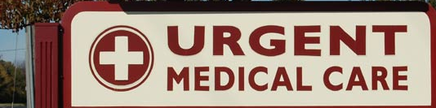
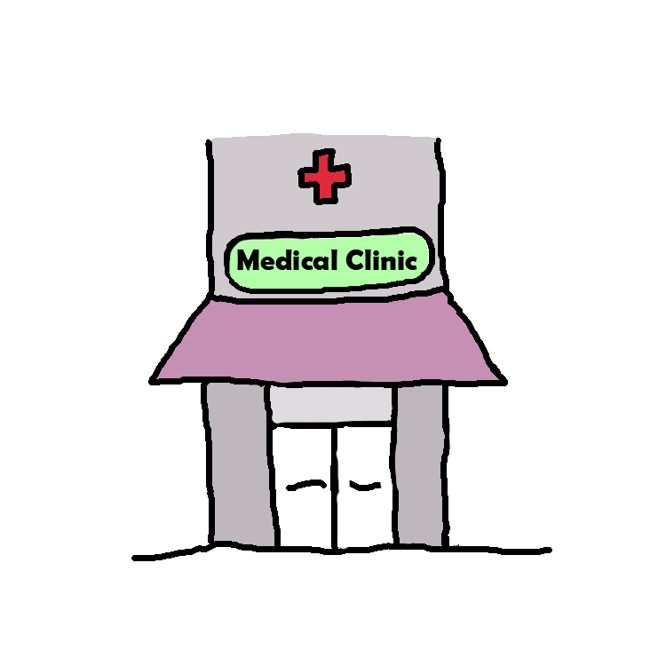
How marketing will be implemented
The partnering with the medical groups will agree as part of their contract that they will distribute and post in their facility the location of our urgent care as it is endorsed by them. This will ensure that the patients within each medical group knows that they can be taken care of at our urgent care because we are in collaboration with them.

Slide 10
Marketing Implementation cont.
Today, 75 % of health care customers study the Internet for information on their symptoms, primary care physician, and what they should do. To effectively influence our target audience, we will invest in a highly enhanced digital strategy that concentrates on user outreach (Solomon, 2016).

Slide 11
Invest in a great website. Since 80 % of patients now find their healthcare provider online, it’s vital to make sure that our website is eye-catching, professional and user friendly (Solomon, 2016) . Crucial parts of data that should be obviously displayed on every page include our location, hours of operation, services and how to contact us.
Cater to mobile users. Today, 63 % of adults use their smartphone to surf the web (Solomon, 2016). It is imperative to invest in responsive web design that acclimates to any device viewing the page. Cell phone users are more likely to abandon a page if it doesn’t adapt to their screen, so it is crucial to cater to a mobile audience.
Invest in local Search engine optimization (SEO). Once we have an operative website, we will need to ensure that people can find us. By investing in local SEO, we will ensure local patients and clients are able to discover our urgent care clinic. By associating with a strategic marketing firm we can assure that the customer will be able to find us.

Slide 12

Our Vision: To provide high-quality urgent care services to our patients and the communities we serve.
The marketing of the urgent care will also include the dynamics of our urgent care.
It will focus on how we deliver the highest quality of care to patients and working with their primary medical group allows for patient to be seen and treated in a timely manner. It will emphasize how we are the first to have the patients visit go directly to their own medical group.
Notes:
The ability to have contracts with the different medical groups and to provide for their patients and be able to share the charting so that the patients primary physician will know the care and treatment that was provided at the visit. We want to make sure that on all the marketing arenas that it is emphasized that we give top quality care.

Slide 13
Measuring Marketing Strategy
We will be using several methods to measure how well our marketing strategy is performing.
Return on investment
Sales numbers
Customer Response
Bounce rate
Notes:
ROI will be looked at this will tell us if the money we invested in marketing is making a profitable difference.
Sales numbers will be measured by the amount of patients that are seen daily and the billing that was done on these patients. A trend will be seen on how many patients are for each medical group and thus what group is giving us the most patients. This will also track the number of walk in patients that are paying cash.
Customer response – With each visit a patient will be sent a survey on how the service was and how did they hear about us. This will then allow us to track how well we are doing and what avenue the patient found out about us was.
Bounce Rate - it provides the percentage of visitors to a company's website that leave shortly after visiting. Bounce rates are high when a number of visitors click through to a website but do not click any additional links or request information from the company. A low bounce rate provides a greater chance of visitors completing the task the marketing campaign was intended to produce.

Slide 14
Leadership and Innovation
In our company we promote the servant leadership model. We want to make our employees reach their maximum potential. Making sure each person reaches their potential will give value to them (Wooden, 2005) and to the team making the patient care experience top quality We start this from the moment they start with us. We believe that holding our standards of quality and care to the highest level will be reached by investing in our staff and leaders so that they can provide the top quality care to our patients with compassion and personal touch to ensure that our patients only get the top medical care and with high quality service.
Notes:
In how we run our business to how we market our business we will do it with dignity and upholding our ethical values. We want to ensure that our top quality care is expressed in not only how we are working with the patients but in how we conduct business. This includes how we deal with our suppliers, medical group contracts, marketing campaigns and in all other aspects of our business.

Slide 15

We ensure that our staff is qualified and follow the caring culture that we have at our Urgent care. Our staff attend training to ensure that they are able to give quality care with compassion. We pride ourselves in developing our staff and promoting a positive work environment.

Slide 16
Innovation
We are the first to contract with several different medical groups so that their patients can be seen in our urgent care.
Our urgent care is the first in having a communication with all contracted medical groups that allow the patients visit to be seen by their primary provider in their medical group.
We will have the ability to see all patient types from medical groups to walk in patients.
Our facility will be run with energy efficient and awareness to our environment.
We will be working with the local school districts to offer a physical exam day towards the beginning of school and for sports physicals. This allows for a cheap physicals and promotion.

